Slide 1

Capstone Project Northwind Sales Analysis ~ By : Anoop Gupta

Slide 2
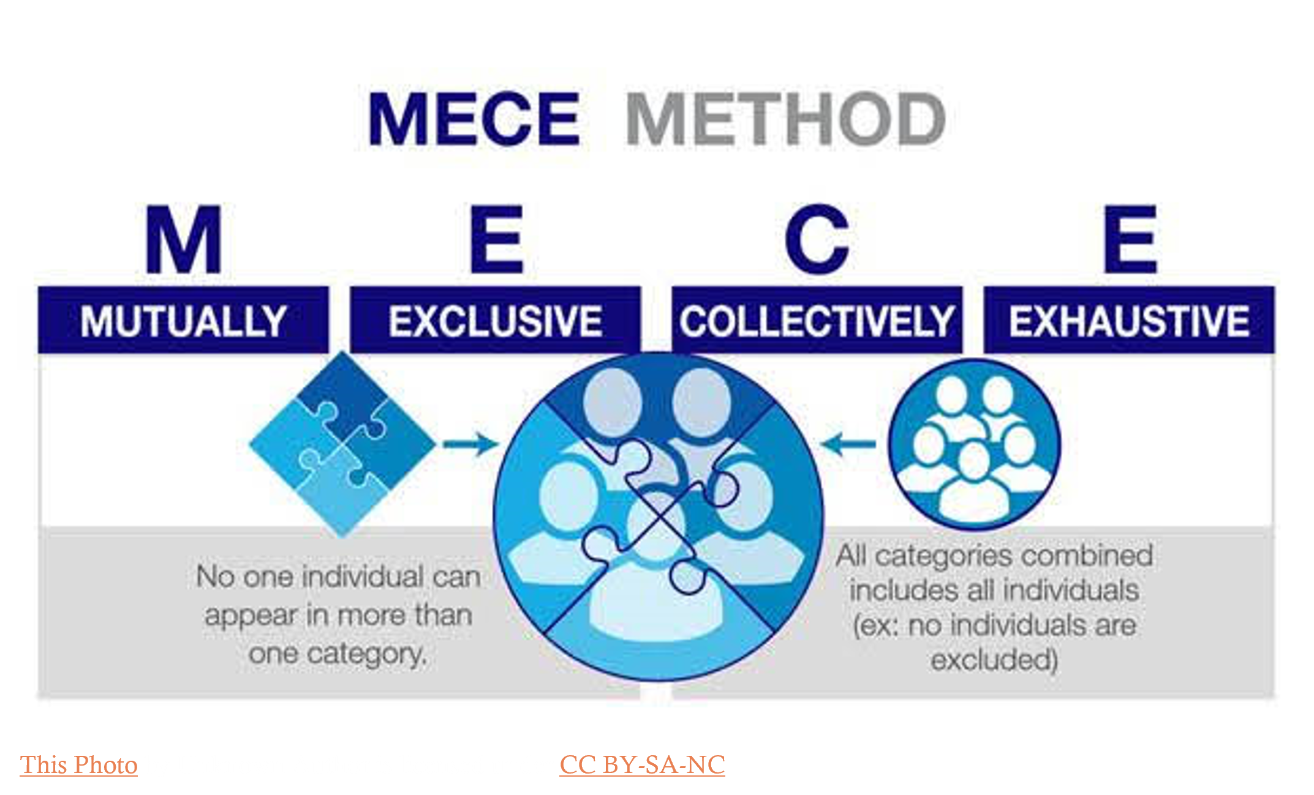
MECE APPROCH

Slide 3
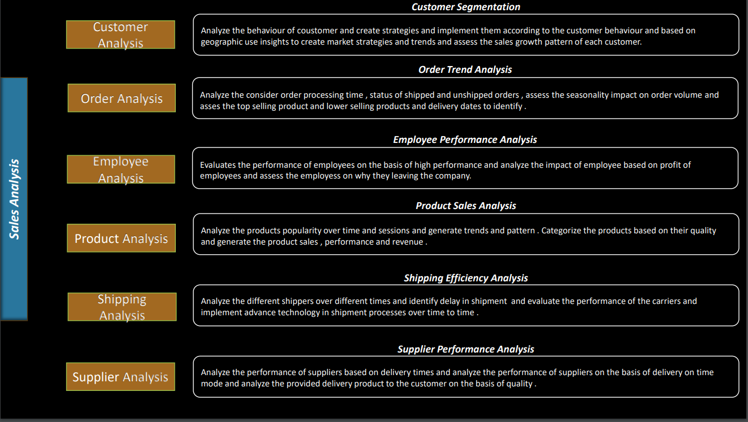

Slide 4



Power BI PROBLEMS

Slide 5
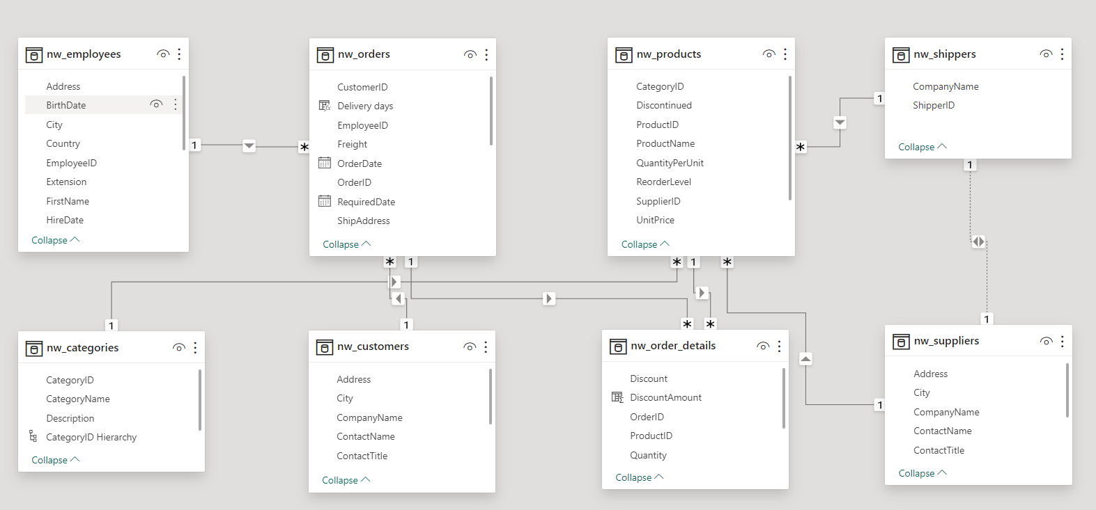
ER DIAGRAM

Slide 6
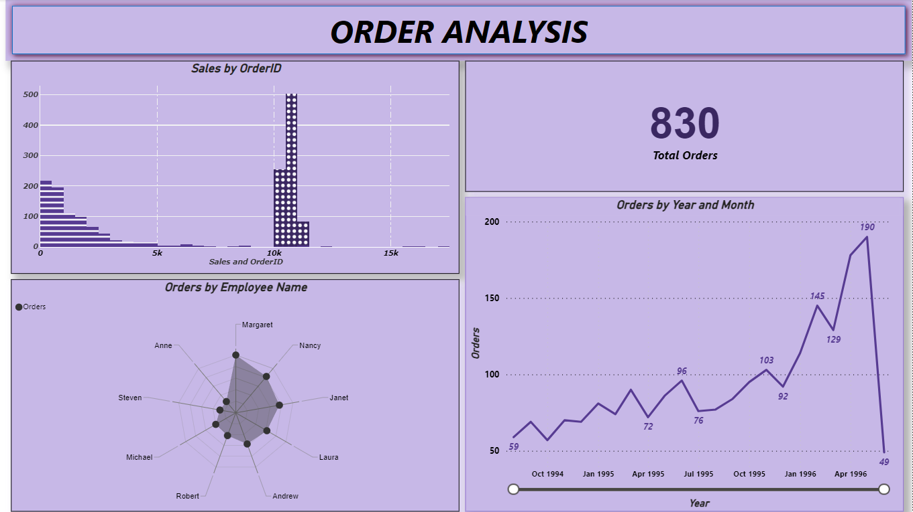

Slide 7
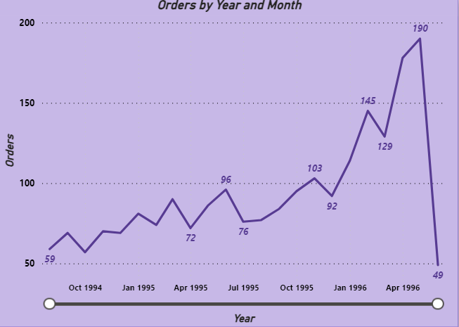
How does order volume change over time?
After analysing the northwind order dataset the order/sales volume is increasing over the period of times of month and years.

Slide 8
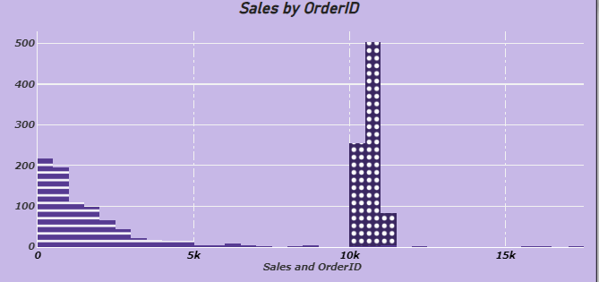
What is the distribution of order values?
After analysing this dataset of orders the distribution of order values is increasing in a sessional way and most of the users is increasing and demanding for this product.

Slide 9
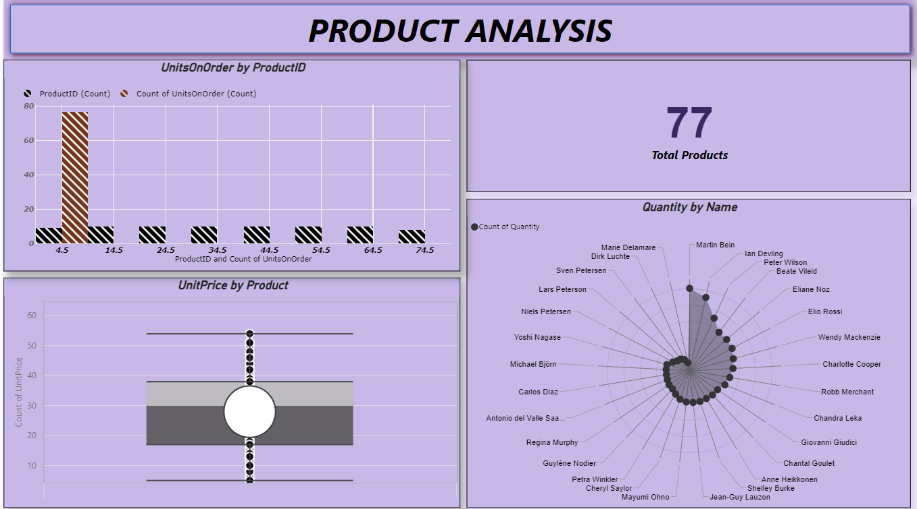

Slide 10
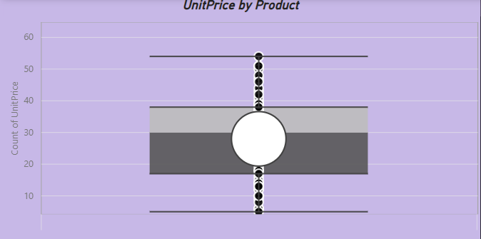
Can we visualize the pricing distribution of products?
After analysing the products dataset the pricing or unit price is increasing by there product demands or sessional demands.

Slide 11
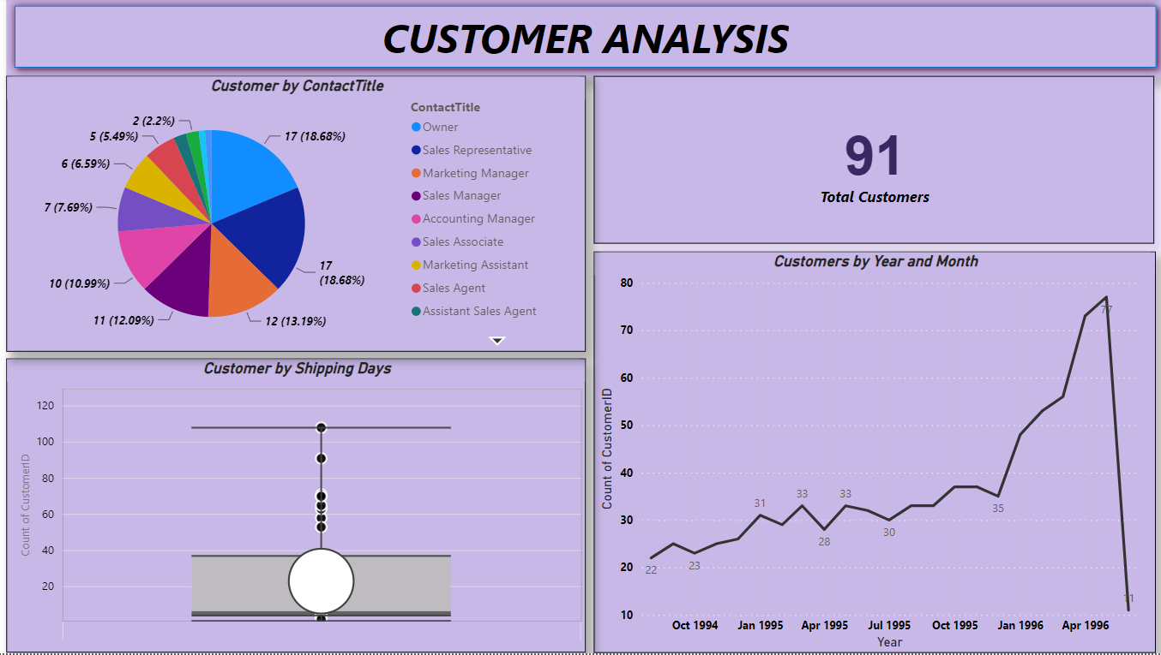

Slide 12
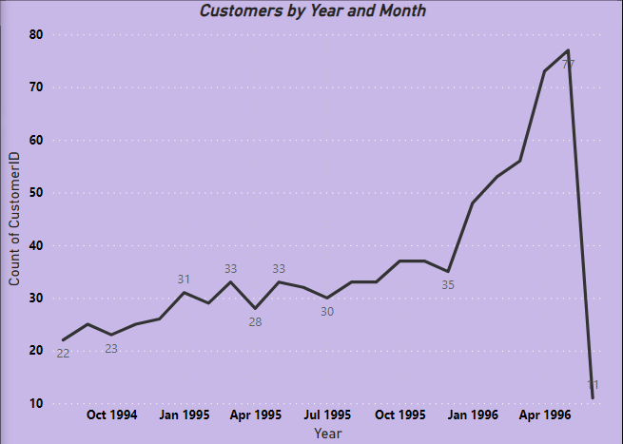
What is the trend in customer acquisition over time?
After analysing the customer dataset the buyers volume is increasing over the period of times of month and years as products are being recognize by peoples.

Slide 13
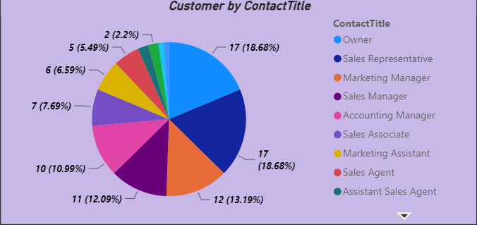
Can we visualize the distribution of customer demographics through contact title ?

Slide 14
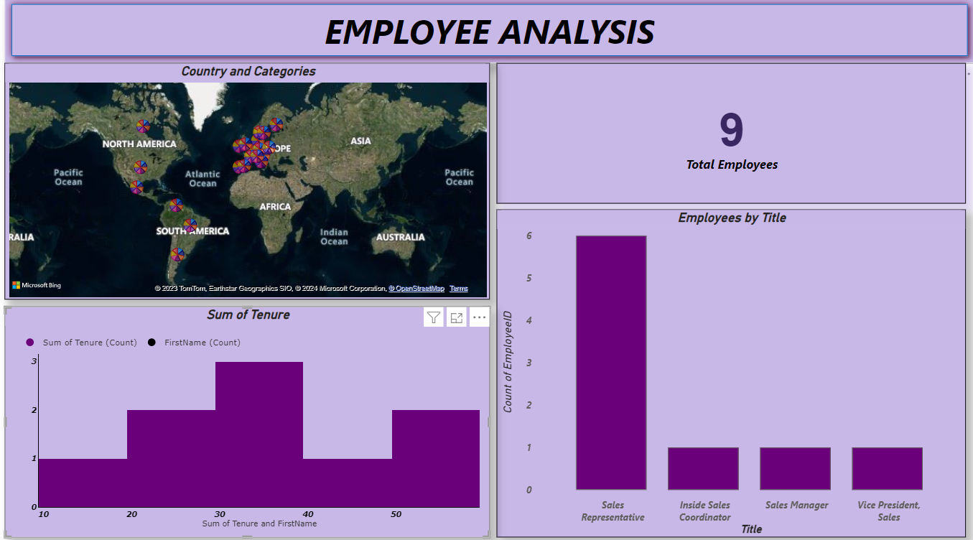

Slide 15
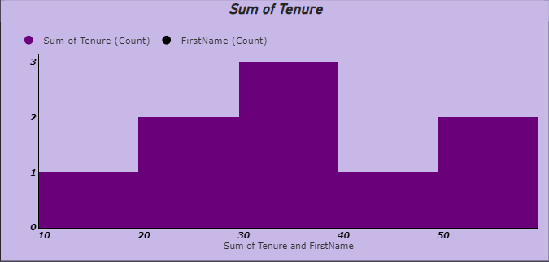
What is the distribution of product ratings or reviews
After analysing the product dataset the product ratings or reviews can be identify by its selled quantity of any products.

Slide 16
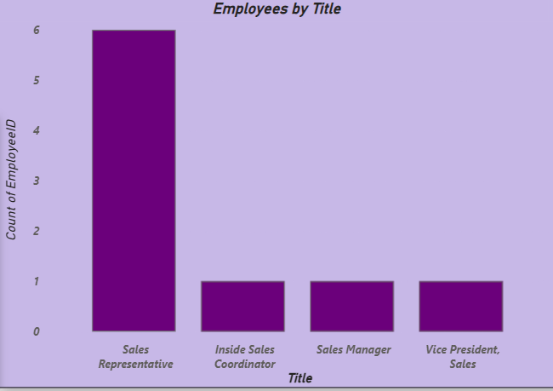
How does employee productivity vary across different departments or job roles
After analysing employee dataset the employee productivity is more in under sales representative than any others .

Slide 17
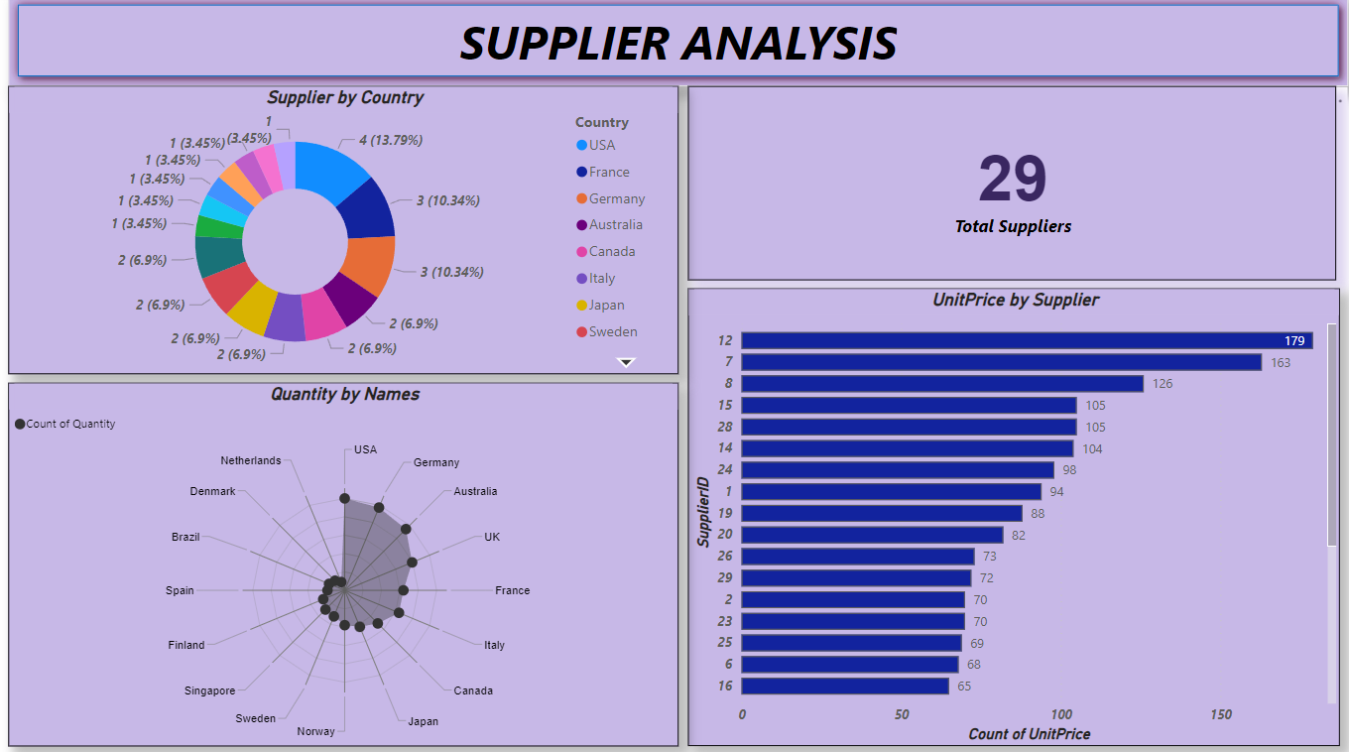

Slide 18
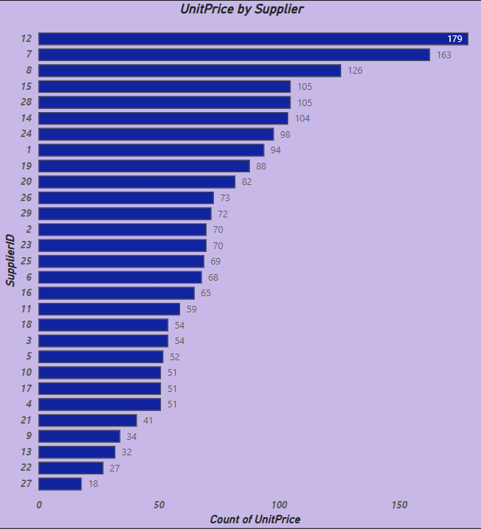
How does the cost or pricing structure vary across different suppliers

Slide 19
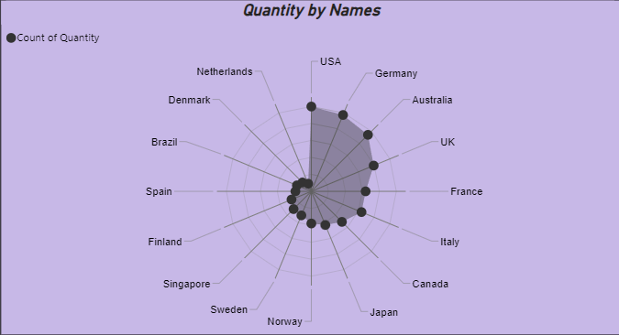
What is the distribution of supplier performance metrics
After analysing the supplier dataset of their performance metrics the quantity of suppliers is more in USA , Germany, Australia ,UK than any other country.

Slide 20
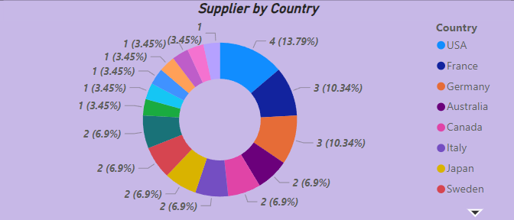
Can we visualize the geographical distribution of suppliers
After analysing this the distributers of the orders are mostly in USA and France than other countries.

Slide 21
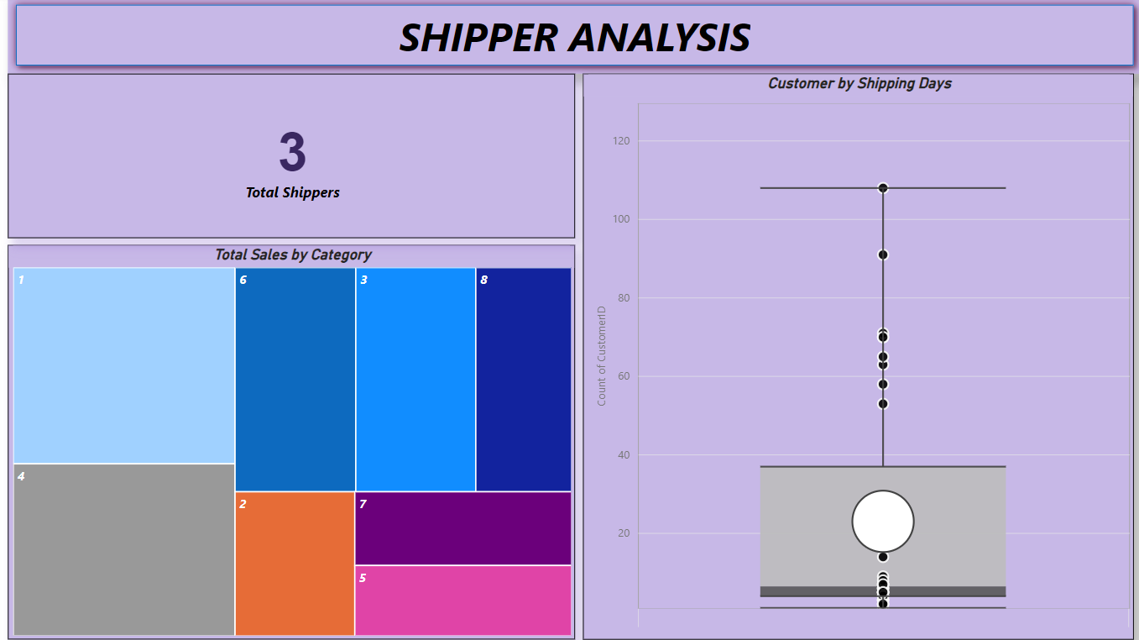

Slide 22
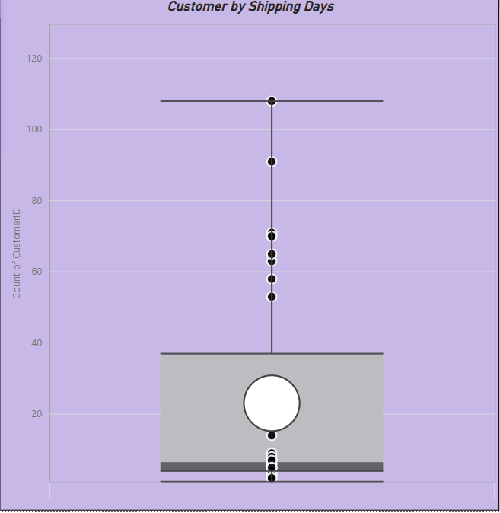
Can we visualize the average order shipping duration

Slide 23
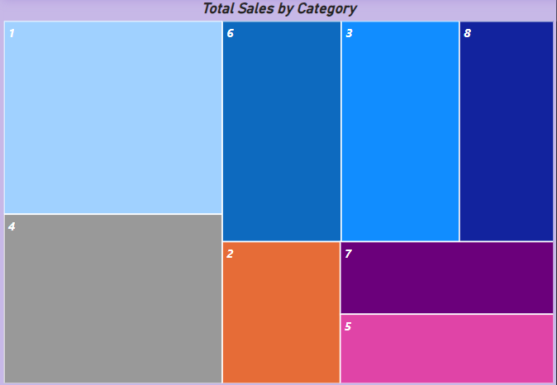
How does the sales volume vary across different product categories

Slide 24
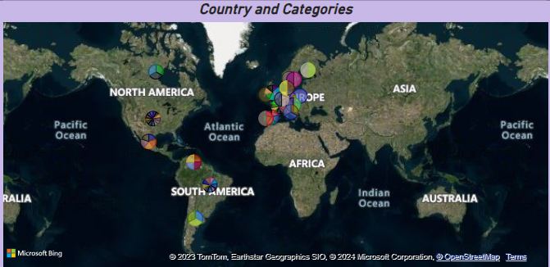
How does customer distribution vary across different regions or customer segments

Slide 25

EDA PROBLEMS

Slide 26
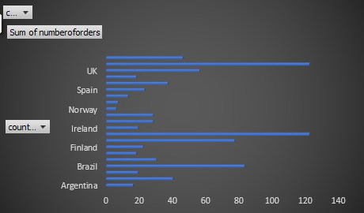
How does order frequency vary across different customer segments
After analysing order and customer segments dataset the frequency of order is more in UK , Ireland than others .

Slide 27
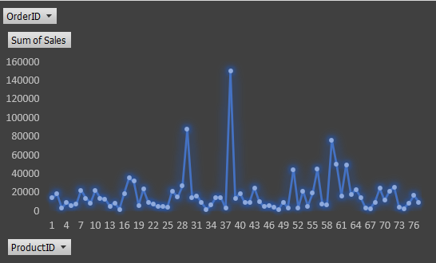
What are the key factors influencing customer retention or loyalty based on the dataset
After analysing the customer retention or loyalty by their sum of sales is product id 37 , 59 have more loyal customers than others .

Slide 28
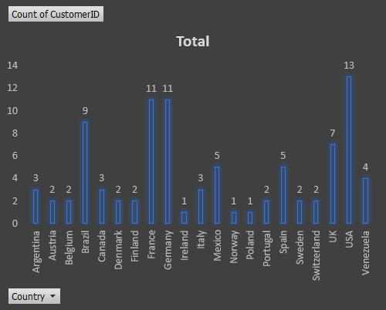
How do customer preferences vary based on their location or demographics
After analysing customer segments dataset the customer most prefrences based on their locations is more in UK , France , Germany than others .

Slide 29
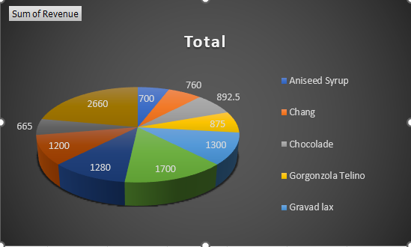
Are there any specific product categories or SKUs that contribute significantly to order revenue
After analysing product categories the order revenue of the items is listed in this 2660 is best revenue of entire products cateegories .

Slide 30
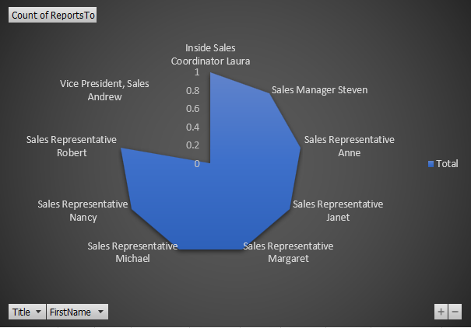
Can we identify any patterns or clusters in employee skill sets or qualifications through visualizations
After analysing employees dataset through title and their names the employees skills are shown below .

Slide 31
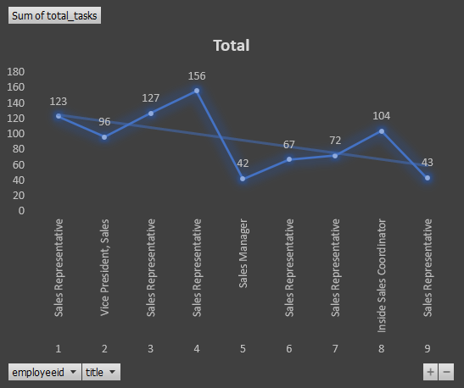
How does supplier performance vary across different product categories or departments
After analysing supplier dataset the sales representative have more tasks to do .

Slide 32


